Slide 1
Splash Screen

Slide 2
Lesson Menu
Five-Minute Check (over Lesson 5–4)
Then/Now
New Vocabulary
Example 1: Solve Equations and Inequalities with Parentheses
Example 2: Solve Multi-Step Equations
Example 3: Standardized Test Example
Example 4: Solve Multi-Step Inequalities
Example 5: Null Set and Identities

Slide 3
5-Minute Check 1
Solve the inequality k + 5 > –2.
A. k > –2
B. k > –7
C. k < 5
D. k > 5

Slide 4
5-Minute Check 2
Solve the inequality
A. n ≤ 2.7
B. n ≥ 2.7
C. n ≤ 8.7
D. n ≥ 8.7

Slide 5
5-Minute Check 3
Solve the inequality
A. t ≤ –4
B. t ≥ –4
C. t ≤ 4
D. t ≥ 4

Slide 6
5-Minute Check 4
A. r < 30
B. r < 3
C. r < –3
D. r < –30

Slide 7
5-Minute Check 5
A. x ≥ –18
B. x ≤ –18
C. x ≥ 18
D. x ≤ 18

Slide 8
5-Minute Check 5
Marilynn and Jackie both run track. Marilynn runs a 50-meter race 3.5 seconds slower than Jackie. It takes Jackie less than 17 seconds to run 50 meters. Which inequality represents how fast Marilynn runs the 50-meter race?
A. m + 17 > 20.5
B. m – 3.5 < 17
C. m + 3.5 < 17
D. m – 17 < 20.4

Slide 9
Then/Now
You have already solved two-step equations and inequalities.
Solve multi-step equations.
Solve multi-step inequalities.

Slide 10
Vocabulary
null or empty set
identity

Slide 11
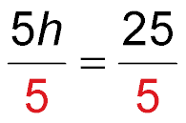
Example 1
Solve Equations and Inequalities with Parentheses
A. Solve 5(h – 2) = 15.
5(h – 2) = 15 Write the equation.
5h – 10 = 15 Distributive Property
5h – 10 + 10 = 15 + 10 Addition Property of Equality
5h = 25 Simplify.
Division Property of Equality
h = 5 Simplify.
Answer: h = 5

Slide 12
Example 1
Solve Equations and Inequalities with Parentheses
B. Solve 2(x – 4) > 11.
2(x – 4) > 11 Write the inequality.
2x – 8 > 11 Distributive Property
2x – 8 + 8 > 11 + 8 Addition Property of Inequality
2x > 19 Simplify.
Division Property of Inequality
x > 9.5 Simplify.
Answer: x > 9.5

Slide 13
Example 1
A. Solve 4(m – 3) = 12.
A. 0
B. 3
C. 6
D. 9

Slide 14
Example 1
B. Solve 3(x – 5) > 12.
A. x > 0
B. x > 2
C. x > 6
D. x > 9

Slide 15
Example 2
Solve Multi-Step Equations
Solve 6(b – 2) = 2(2b + 8). Check your solution.
6(b – 2) = 2(2b + 8) Write the equation.
6b – 12 = 4b + 16 Distributive Property
6b – 12 + 12 = 4b + 16 + 12 Addition Property of Equality
6b = 4b + 28 Simplify.
6b – 4b = 4b – 4b + 28 Subtraction Property of Equality
2b = 28 Simplify.
b = 14 Division Property of Equality
Answer: b = 14

Slide 16
Example 2
Solve 4(r + 2) = 2(3r – 6).
A. 4
B. 5
C. 7
D. 10

Slide 17
Example 3
The Carleton Company budgeted $1825 for a banquet. The cost of the facility is $225. How much can the company spend per guest on food if there is a $3 charge per guest for linens and there are 80 guests coming to the banquet?
A $15 B $17 C $20 D $25
Read the Test Item You need to find the amount per guest to spend for food.

Slide 18
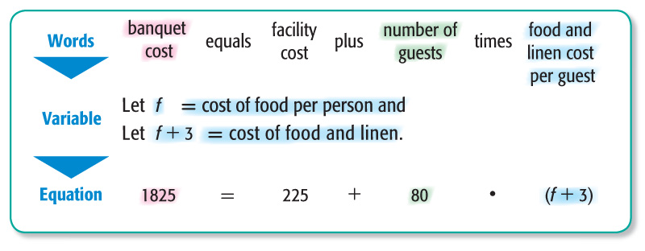
Example 3
Solve the Test Item

Slide 19
Example 3
1825 = 225 + 80(f + 3) Write the equation.
1825 = 225 + 80f + 240 Distributive Property
1825 = 465 + 80f Simplify.
1825 – 465 = 465 – 465 + 80f Subtraction Property of Equality
1360 = 80f Simplify.
17 = f Division Property of Equality
Answer: The answer is B.

Slide 20
Example 3
Erica is planning a party for 15 guests. Each guest will receive a photo that costs $2. She has $105 to spend altogether. How much can she spend per person for food?
A. $3
B. $5
C. $6.50
D. $7.50

Slide 21
Example 4
Solve Multi-Step Inequalities
Solve 5x – 9 ≥ 2(x + 6). Graph the solution on a number line.
5x – 9 ≥ 2(x + 6) Write the inequality.
5x – 9 ≥ 2x + 12 Distributive Property
5x – 9 + 9 ≥ 2x + 12 + 9 Addition Property of Inequality
5x ≥ 2x + 21 Simplify.

Slide 22
Example 4
Solve Multi-Step Inequalities
5x – 2x ≥ 2x + 21 – 2x Subtraction Property of Inequality
3x ≥ 21 Simplify.
x ≥ 7 Division Property of Inequality
Answer: x ≥ 7

Slide 23
Example 4
Which number line displays the solution of 5x – 8 ≥ 3(x + 4)?
A.
B.
C.
D.

Slide 24
Example 5 A
Null Set and Identities
A. Solve 3(4x – 2) + 15 = 12x + 9.
3(4x – 2) + 15 = 12x + 9 Write the equation.
12x – 6 + 15 = 12x + 9 Distributive Property
12x + 9 = 12x + 9 Simplify.
12x + 9 – 12x = 12x + 9 – 12x Subtraction Property of Equality
9 = 9 Simplify.
The statement 9 = 9 is always true.
Answer: The equation is an identity and the solution is all numbers.

Slide 25
Example 5 B
Null Set and Identities
B. Solve 7y – 8 = 3(2y + 4) + y.
7y – 8 = 3(2y + 4) + y Write the equation.
7y – 8 = 6y + 12 + y Distributive Property
7y – 8 = 7y + 12 Simplify.
7y – 8 – 7y = 7y + 12 – 7y Subtraction Property of Equality
–8 = 12 Simplify.
The statement –8 = 12 is never true.
Answer: The equation has no solutions and the solution set is Ø.

Slide 26
Example 5
A. Solve 10a – 9 = 5(2a – 3) + 6.
A. 0
B.
C. The solution set is Ø.
D. The solution set is all numbers.

Slide 27
Example 5
B. Which equation has no solution?
A. 8x – 2 = 2(x – 4)
B. 8x – 2 = 2(x + 4)
C. 8x – 2 = 2(4x – 1)
D. 8x – 2 = 2(4x + 1)

Slide 28
End of the Lesson

